Slide 1
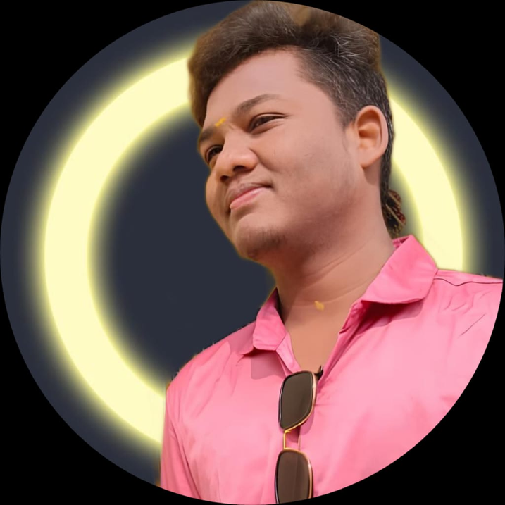
SANTHOSHKUMAR.S
Software Developer

Slide 2
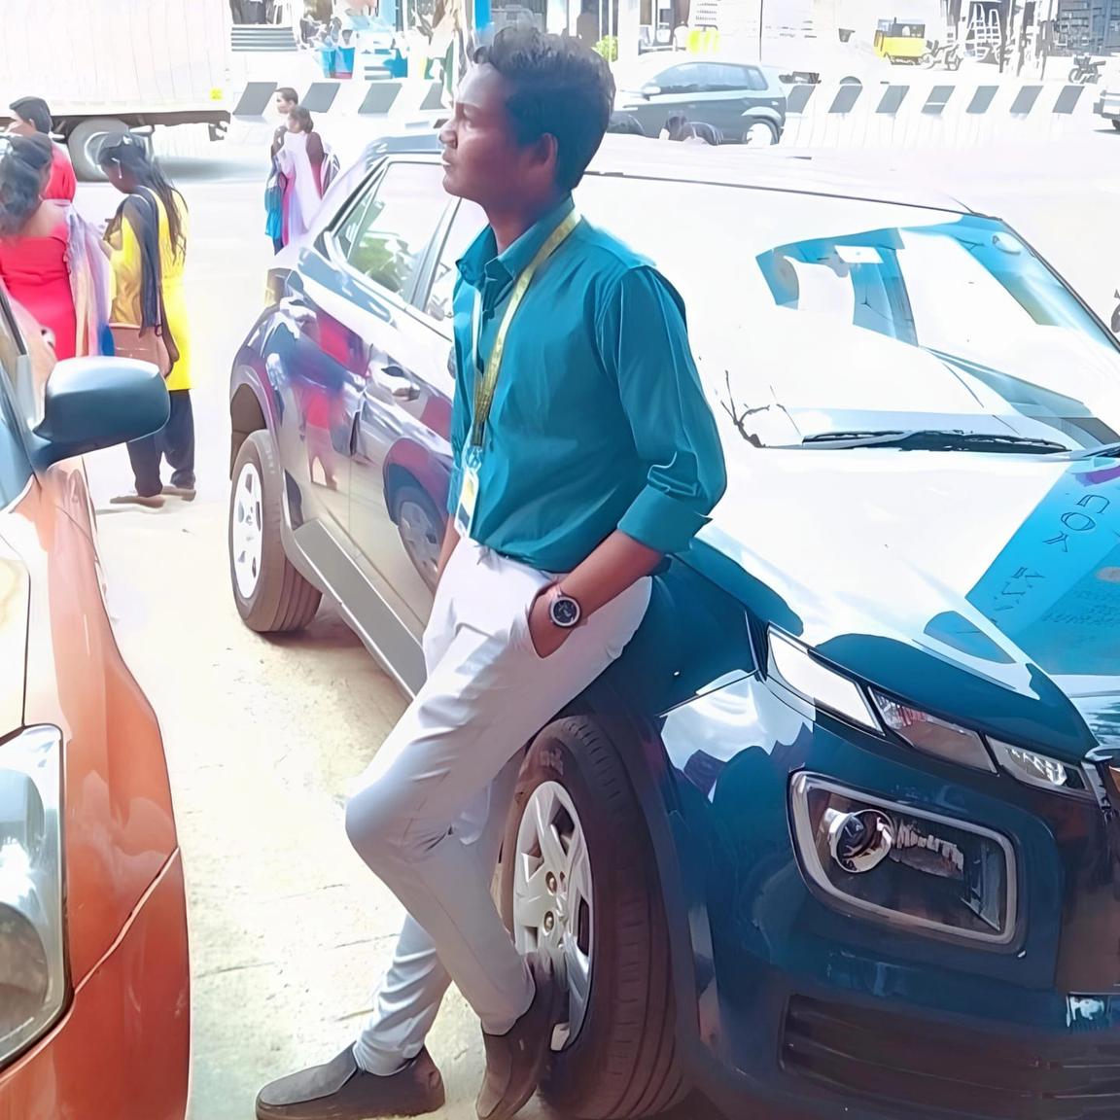
Introduction
About me
Hi, I’m S.Santhoshkumar a passionate BCA graduate (2025) driven by curiosity, creativity, and a love for problem-solving. I enjoy turning ideas into reality—whether that’s building interactive websites, crafting engaging content, or exploring the possibilities of AI tools.
My skillset spans across web development (HTML, CSS, Js), programming languages like C, C++, Java, Python, SDLC & OOPS concepts, Sql, Mysql and AI-powered solutions like ChatGPT prompt design.

Slide 3
Projects
Word Survival :
Word Survival is a web-based word guessing game inspired by the classic Hangman concept. The goal of the game is to challenge users to correctly guess a hidden word within a limited number of attempts.
Players are presented with a series of blank spaces that represent the letters in the target word. For each incorrect guess, the number of remaining chances decreases bringing the player closer to “losing” the survival battle. If all letters are guessed correctly before the attempts run out, the player wins; otherwise, the game ends.
The game includes:
A clean and user-friendly interface
Real-time updates as the player guesses letters
A logic system to track used letters and remaining attempts
A winning/losing message at the end of each round
This project helped strengthen my knowledge of JavaScript, HTML, and CSS, especially in the areas of DOM manipulation, game logic, and responsive UI design.

Slide 4

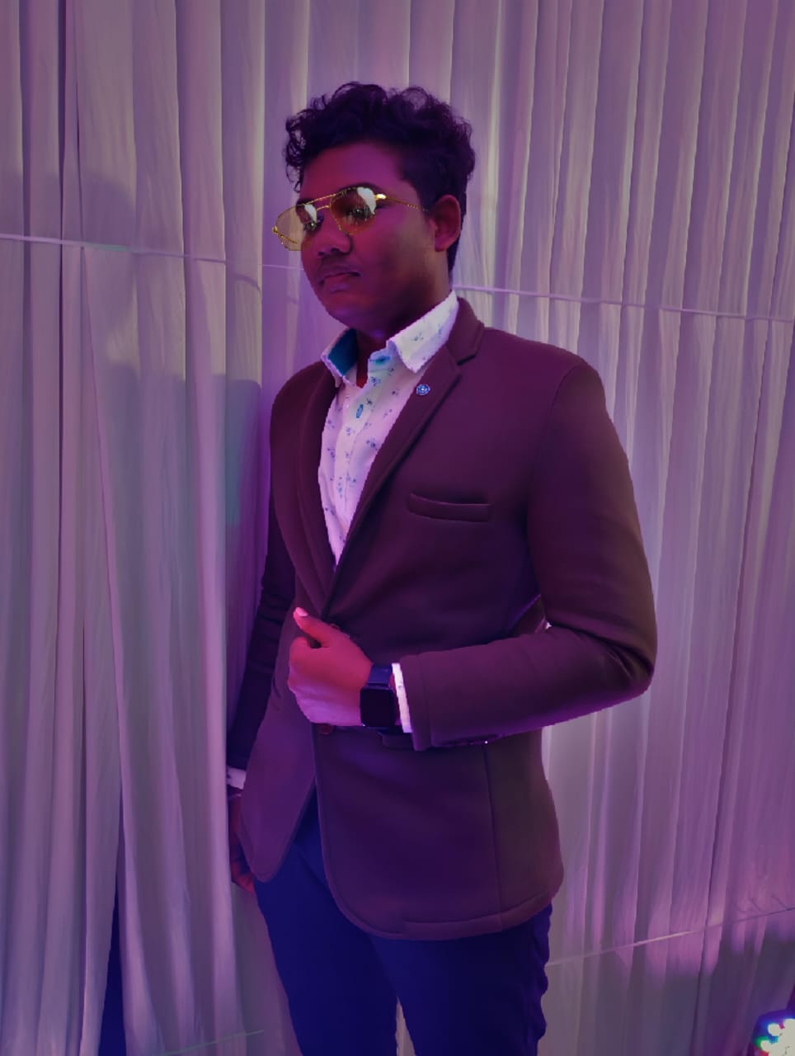
Educational Background
Jaigopal Garodia National Higher Secondary School
SSLC - 51.8%
HSC - 63.3%
2019 - 2020
2021 - 2022
Prince Shri Venkateshwara Arts & Science College
Bachelor Of Computer Application - 65%
2023- 2025

Slide 5

Personal Skills
Programming :
API & Version Controls :
Tools, IDEs & Databases :
Html 5
Css 3
JavaScript
Python
GIT
GITHUB
APIs
Android Studio
Visual Studio
Python IDLE 3.12
Pl/Sql

Slide 6

Certificates
Cloud Computing
IBM Python
Mongodb Nodejs
Oracle
Mongodb Database

Slide 7

Achievements
Conducted Codeflip Event In Prince Shri Venkateshwara Arts & Science College
(02/2025)
Runner In Zepher Event At Madha Engineering College
(04/2024)

Slide 8
Contact Me
Mobile Number : 6379002985
E-mail : sandy637900@gmail.com
Linkedin : https://www.linkedin.com/in/s-santhosh-kumar-50b148338
Github : https://github.com/sandykumars
Instagram : https://www.instagram.com/its_me_santhosh_ks?igsh=bmtlY3IyaWR1OHhy
Facebook : https://www.facebook.com/share/16RLZu82zz/
Twitter : https://x.com/sandy637900?t=kTwrgHPy8pg8lK5K4bUw9A&s=09

